Slide 1
Single Page Application
Lecturer: Ngo Huy Bien
Software Engineering Department
Faculty of Information Technology
VNUHCM - University of Science
Ho Chi Minh City, Vietnam
nhbien@fit.hcmus.edu.vn

Slide 2

Objectives

Slide 3

Contents

Slide 4

References
Emmit Scott (2015). SPA Design and Architecture. Manning Publications.
Michael S. Mikowski and Josh C. Powell (2013). Single Page Web Applications - JavaScript End-to-End. Manning Publications.
Bruno Joseph D'mello et al. (2017). Web Development with MongoDB and Node.
Luca Mezzalira (2022). Building Micro-Frontends. O'Reilly Media.

Slide 5
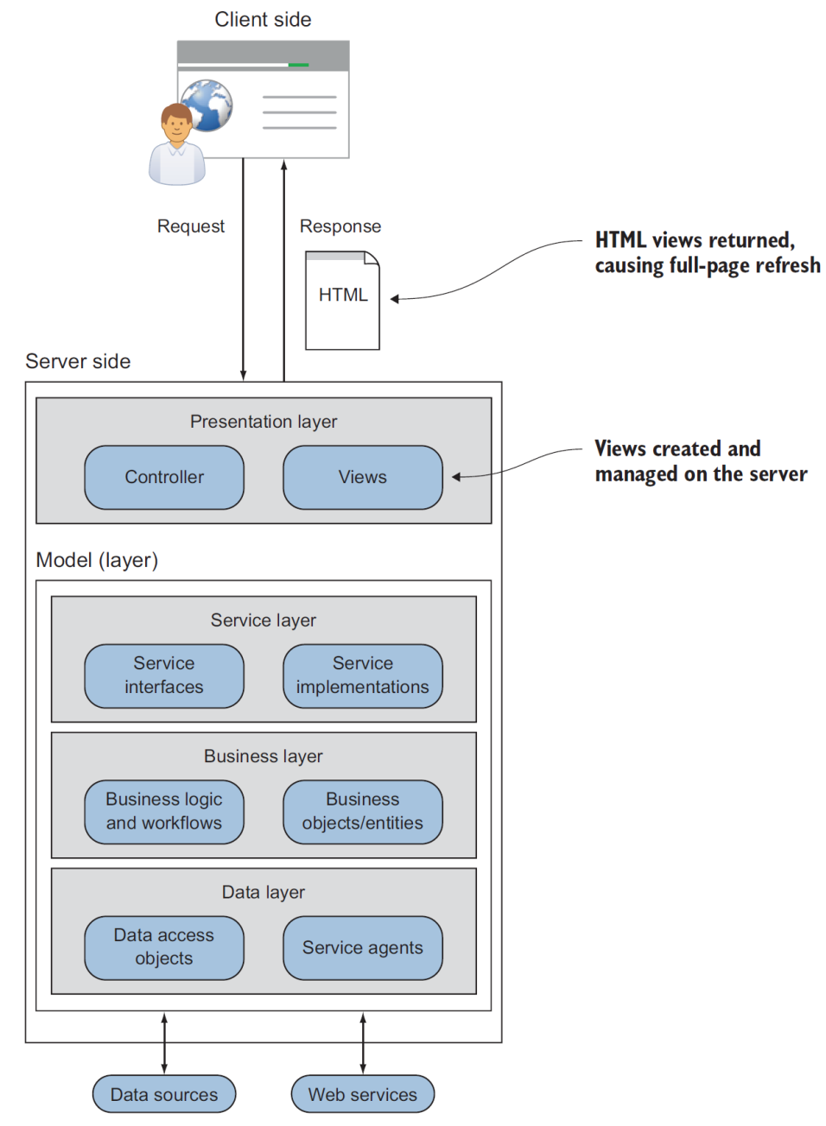
A Traditional Web Application [1]
In a traditional web application, each new view (HTML page) is constructed on the server.

Slide 6
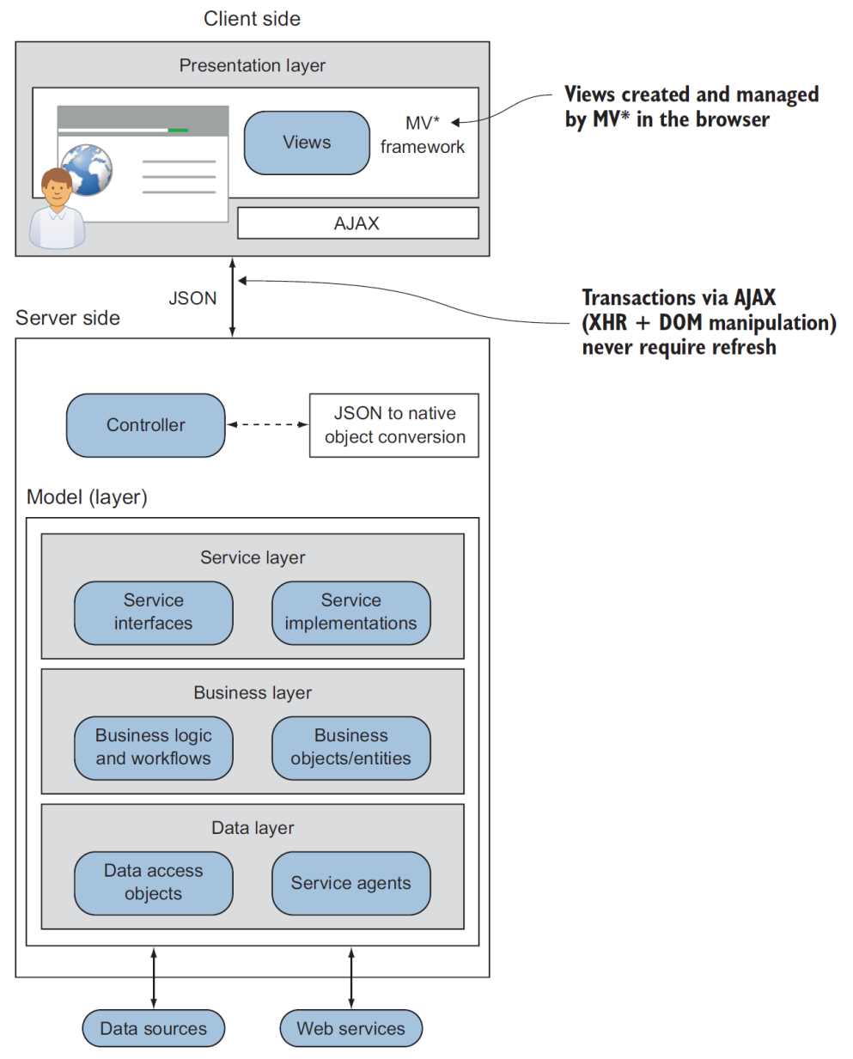
Single-Page Web Application
In an SPA, the presentation layer moves to the client-side code, and transactions never require a browser refresh.

Slide 7
A Little History [2]
The Java applets approach.
The Flash/Flex approach.
What took JavaScript SPAs so long?
HTML5, SVG, and CSS3 standards and support have advanced—These advancements allow for the rendering of pixel-perfect graphics that can rival the speed and quality produced by Java or Flash.
JavaScript now is cross-platform due to converging implementations of standards across browsers.
JavaScript has become surprisingly fast—Modern JavaScript implementations enjoy advanced optimizations such as JIT compilation to native machine code, branch prediction, type-inference, and multi-threading.
JavaScript has evolved to include advanced features—These features include the JSON native object, native jQuery-style selectors, and more consistent AJAX capabilities.

Slide 8
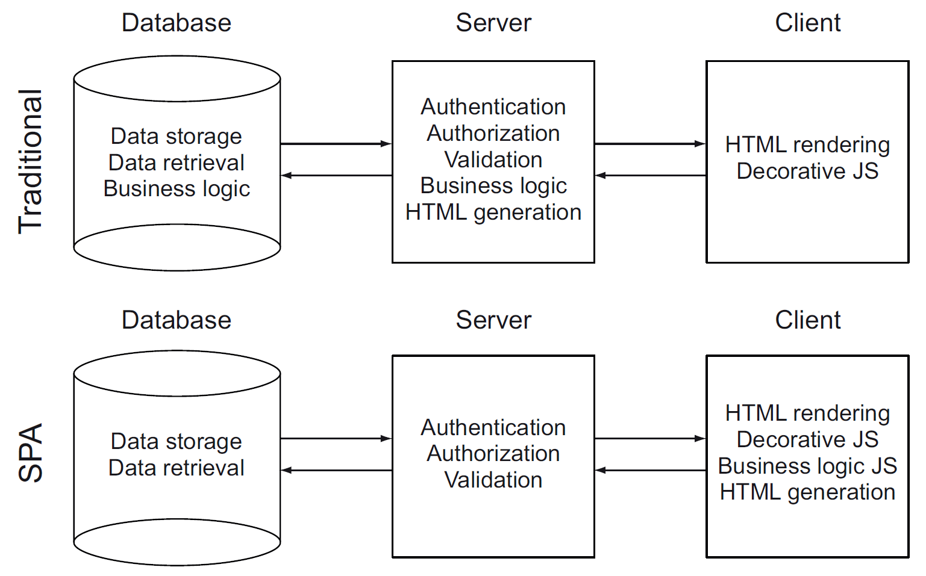
From Traditional WA To SPA
The business logic and generation of HTML migrates from the server to the client.
Note: Business logic = navigation + data presentation.

Slide 9
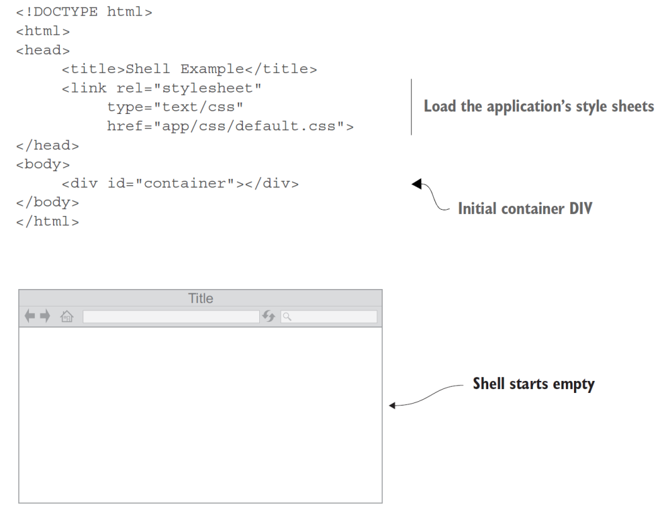
The SPA Shell [1]
The single-page part of the SPA refers to the initial HTML file, or shell.
This single HTML file is loaded once and only once, and it serves as the starting point for the rest of the application.

Slide 10
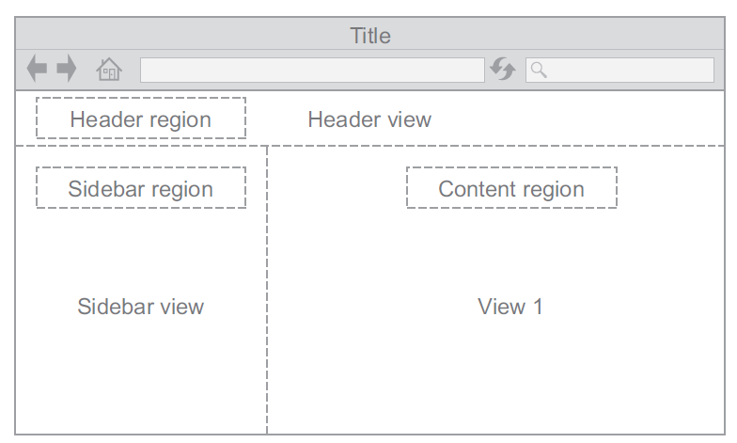
Regions
The initial container DIV can have child containers beneath it if the application's viewable area is divided into subsections.
Subsections of the shell are called regions.
A region's content is provided by a view.

Slide 11
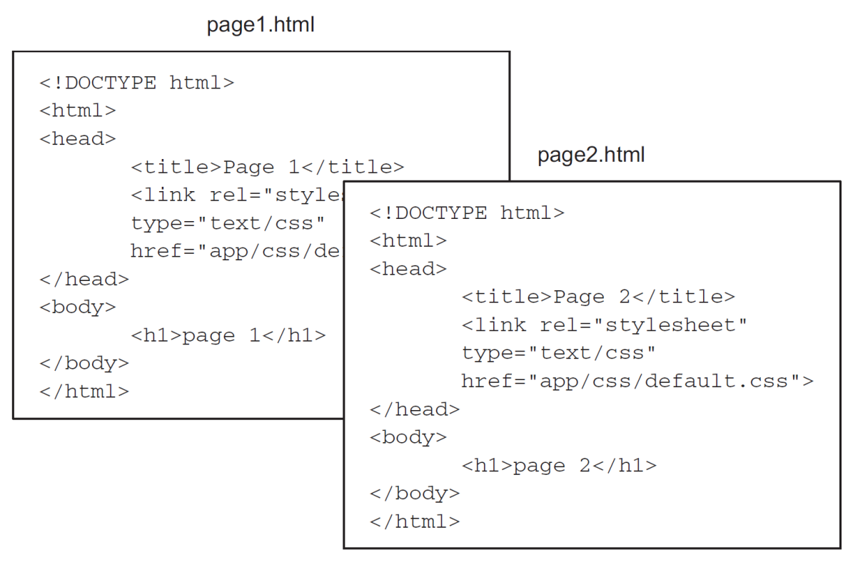
Traditional Site Design
In traditional site design, each HTML file is a complete HTML page.

Slide 12
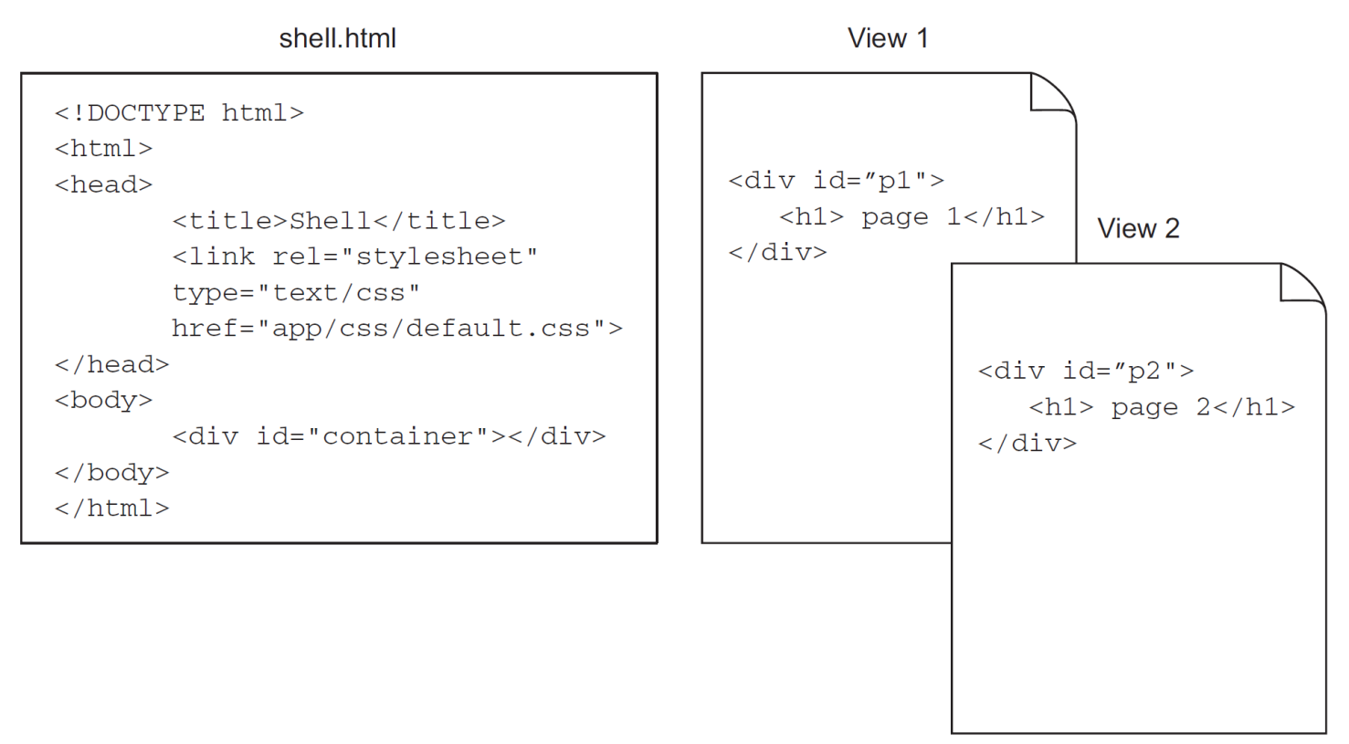
SPA Design
In an SPA design, one complete HTML file contains placeholders for the HTML fragments stored in view files.
When the application starts, the MV* framework inserts view 1. When the user navigates to what appears to be a new page, the framework is swapping view 1 for view 2.

Slide 13
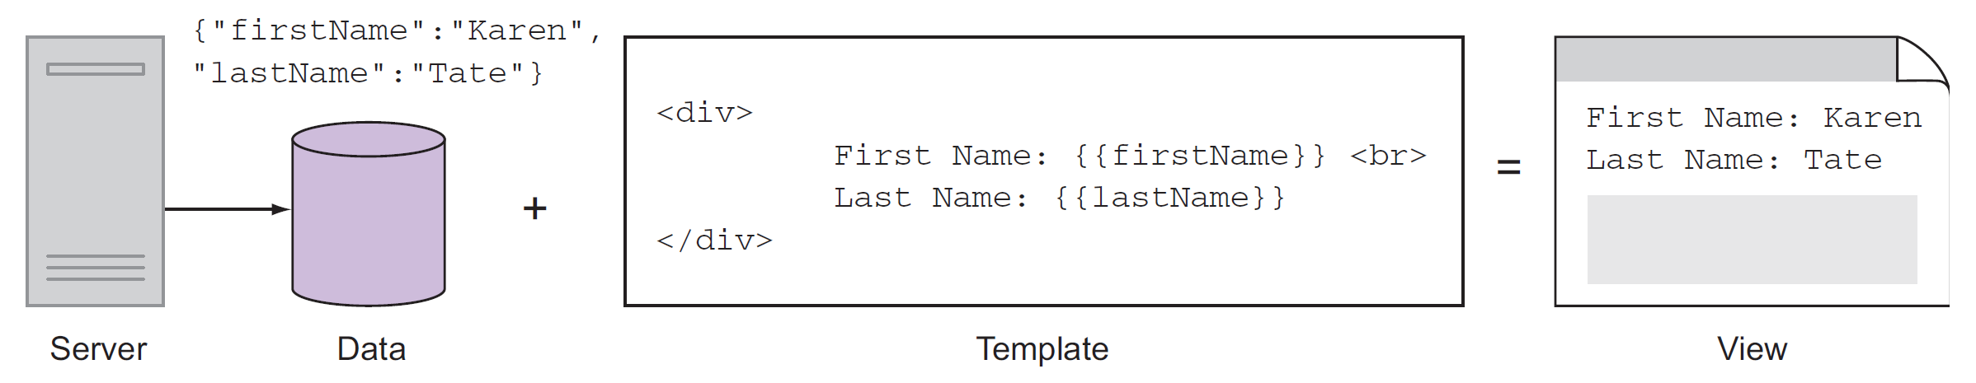
Template
The skeletal HTML structure of each section, called a template, contains placeholders for data.
A view is the marriage of data and one or more templates.

Slide 14
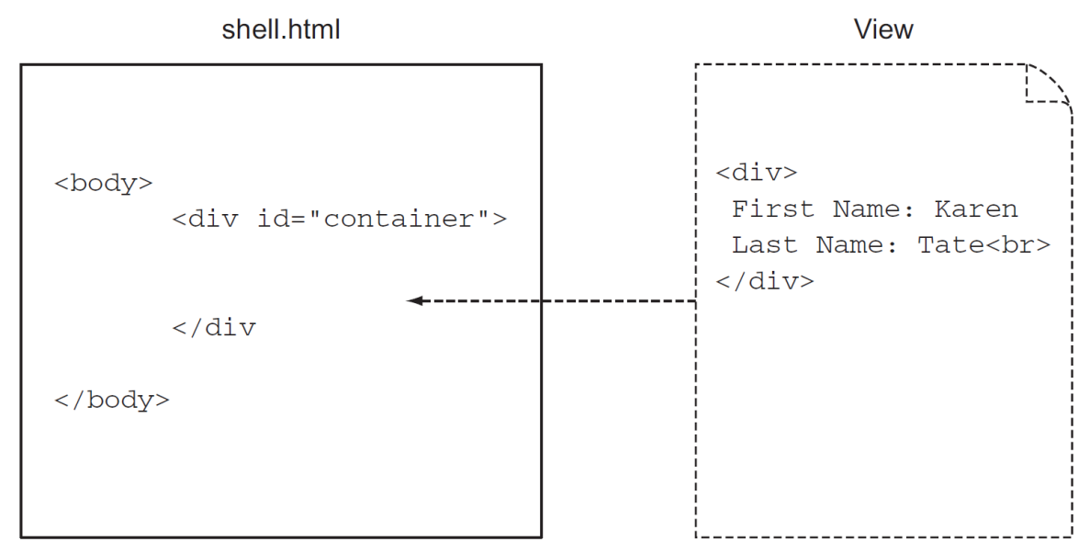
Updating DOM Content
Views are attached to the DOM dynamically, usually as a result of user navigation, beneath the initial container DIV or one of its regions.

Slide 15
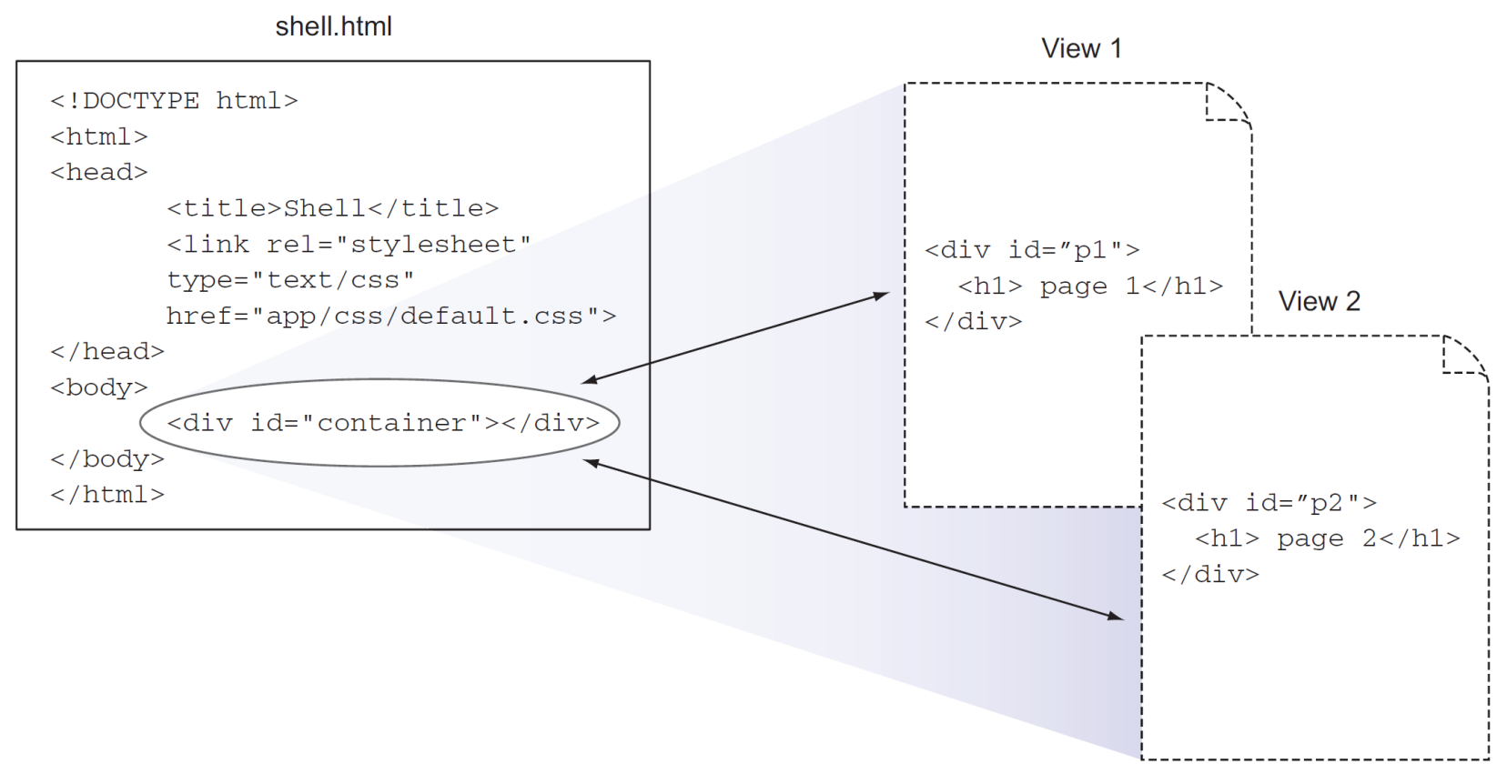
Swapping Views
Views in an SPA are seamlessly swapped (through DOM manipulation) for a given area of the screen, giving the user a more desktop-like feel.
The heavy lifting of creating and managing the views in the client is handled by MV* frameworks.

Slide 16
Benefits of SPAs over Traditional WAs
Renders and provides user experience like a desktop application.
Faster, lightweight transaction payloads.

Slide 17


Slide 18
SPA Implementation Approach (I) [3]
If we rely on full-page postbacks every time, we need to facilitate one of these requests; our app will feel sluggish and unresponsive, as the user will have to wait for a full round trip with every request.
Fortunately, we were able to easily rectify this using jQuery and AJAX. This is a perfect example of how a single page application works (only on a much larger scale).

Slide 19
SPA Implementation Approach (II)
Creating an SPA typically involves having a single HTML page as the source of the application, which loads all of the necessary JavaScript in order to trigger a series of events that include:
Bootstrapping the app: This means connecting to the server via AJAX to download the necessary startup data.
Rendering the screens based on user actions: This means monitoring events triggered by the user and manipulating the DOM so that sections of the app are hidden, revealed, or redrawn, which emulates the feel of a desktop application.
Communicating with the server: This means using AJAX to constantly send and receive data from the server, which maintains the illusion of a stateful connection via the browser.

Slide 20
SPA from Scratch Tools [2]
Our client libraries include jQuery for DOM manipulation with plugins for history management and event handling.
We use TaffyDB2 to provide high-performance, data-centric models.
Socket.IO provides seamless near-real-time messaging between the web server and the client.
On the server, we use Node.js for our event-based web server.
We also use Socket.IO on the web server.
Our database is MongoDB, a noSQL database that uses the JavaScript native data format, JSON, to store data and also has a JavaScript API and command-line interface.

Slide 21
Why Use a Frontend Framework?
We use frameworks to increase our productivity.
Any amount of complex code is eventually going to need to be properly organized, and we need to use a standard set of reusable tools to achieve common tasks.
A framework allows us to organize our code, and it extrapolates out a lot of boilerplate code, freeing up our time to focus on our custom business logic.

Slide 22
AngularJS
https://angular.io/
One framework. Mobile & desktop.

Slide 23
React
https://reactjs.org/
A JavaScript library for building user interfaces

Slide 24
Vue
https://vuejs.org/
Vue (pronounced /vjuː/, like view) is a progressive framework for building user interfaces.
Unlike other monolithic frameworks, Vue is designed from the ground up to be incrementally adoptable.
The core library is focused on the view layer only, and is easy to pick up and integrate with other libraries or existing projects.

Slide 25
Backbone.js
https://backbonejs.org/
Backbone.js gives structure to web applications by providing models with key-value binding and custom events, collections with a rich API of enumerable functions, views with declarative event handling, and connects it all to your existing API over a RESTful JSON interface.

Slide 26
Grunt.js
https://gruntjs.com/
The JavaScript Task Runner
Why use a task runner?
In one word: automation.

Slide 27
Bower
https://bower.io/
Web sites are made of lots of things — frameworks, libraries, assets, utilities, and rainbows.
Bower manages all these things for you.

Slide 29
Lit
https://lit.dev/
Developed by Google
Building on top of the Web Components standards, Lit adds just what you need to be happy and productive: reactivity, declarative templates and a handful of thoughtful features to reduce boilerplate and make your job easier. Every Lit feature is carefully designed with web platform evolution in mind.
Every Lit component is a native web component, with the superpower of interoperability. Web components work anywhere you use HTML, with any framework or none at all. This makes Lit ideal for building shareable components, design systems, or maintainable, future-ready sites and apps.

Slide 30
Stencil
https://stenciljs.com/
Created by the Ionic Framework team.
Stencil is a compiler that generates Web Components (more specifically, Custom Elements) and builds high performance web apps. Stencil combines the best concepts of the most popular frameworks into a simple build-time tool.
Stencil takes features such as
Virtual DOM
Async rendering (inspired by React Fiber)
Reactive data-binding
TypeScript
JSX
Static Site Generation (SSG)
and then generates standards-based Web Components and web apps with these features baked in.

Slide 32
SPA Tradeoffs [4]
Downloading all the application logic in one go can be a disadvantage as well because it can lead to potential memory leaks when the user is jumping from one view to another if the code is not well implemented and does not correctly dispose of the unused objects.

Slide 33
Progressive Web Apps
Progressive web apps provide a set of new capabilities based on service workers.
A service worker is a script that your browser runs in the background, separate from a web page, for providing functionality such as offline experience or push notifications.
Thanks to service workers, we can now create our caching strategy for a web application, with native APIs available inside the browsers.
If a resource is cached and available offline, return it first before trying to download it from the server. If it isn't in the cache already, download it and cache it for future usage.

Slide 34

Thank You & See You Again

